Slide 1
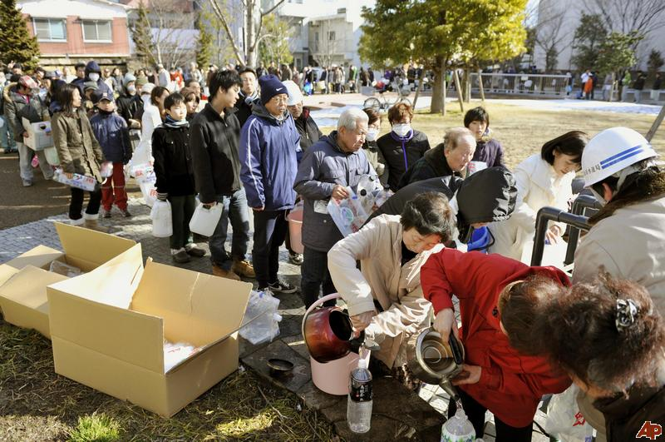
Water Resources and Pollution
“When the well is dry, we learn the worth of water.”
- Benjamin Franklin

Slide 2
Water Usage
Water use is measured in two ways:
Water withdrawal measures the total amount diverted or withdrawn from a source.
Example: Coolant water withdrawn by a power plant, then returned to the river.
Water consumption measures water permanently removed from a source.
Example: Water is sprayed on crops for irrigation, then evaporates or transpires into the atmosphere.

Slide 3
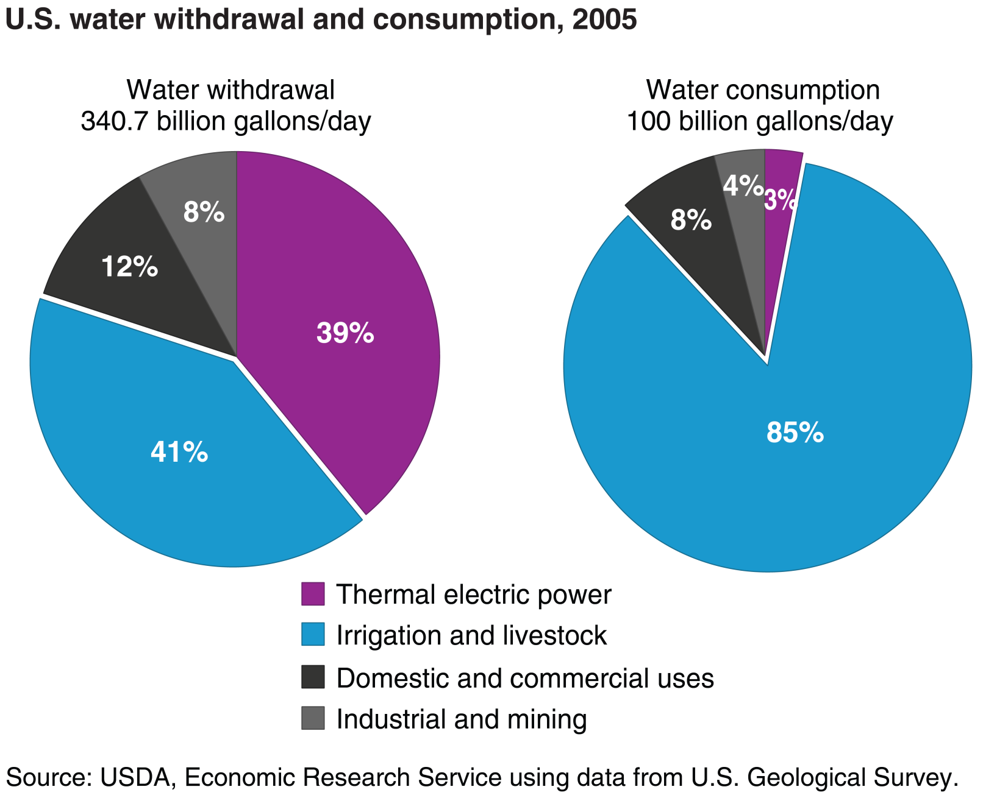
Agriculture makes up the majority of both water withdrawal and consumption.

Slide 4
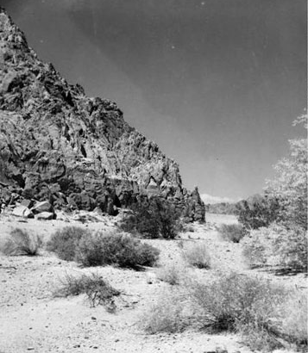
The Salton Sea
The Salton Sink is a waterless depression in southeastern California, part of the Sonoran desert.
At one point, the sink was actually the bottom of a huge freshwater lake.
Salton Sink, showing the water line of Lake Cahuilla.

Slide 5
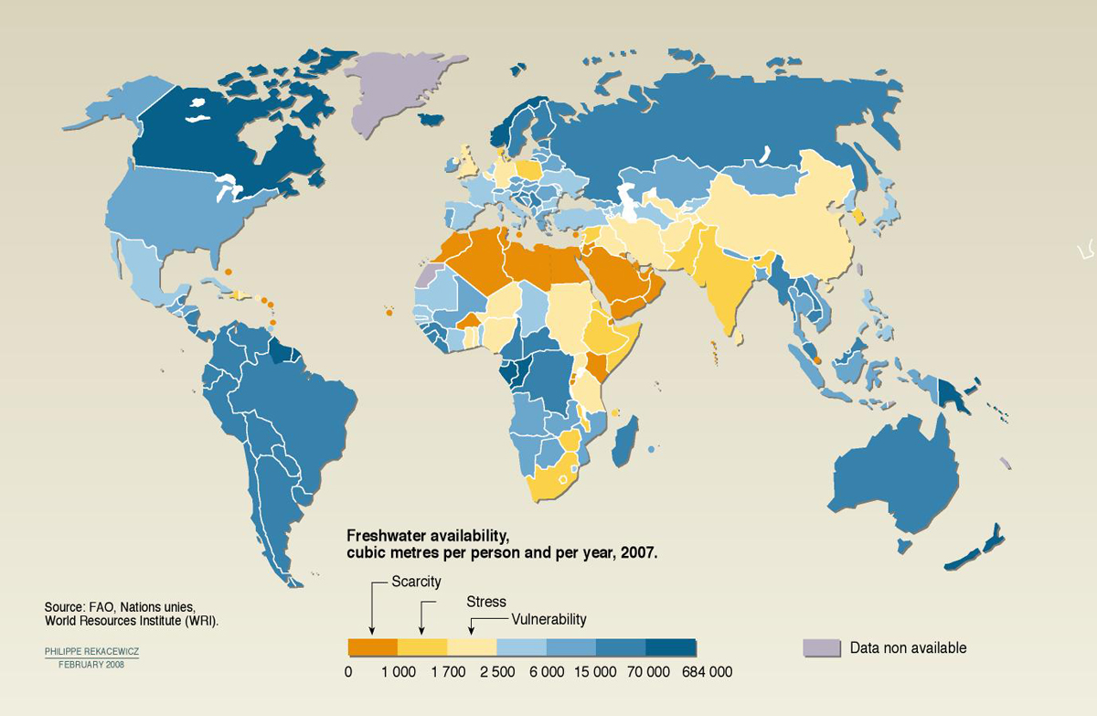
The Salton Sink was an area experiencing water scarcity, meaning there was not enough access to freshwater to drink or grow food.
Countries experiencing water scarcity tend to be in highly populated and dry regions.

Slide 6
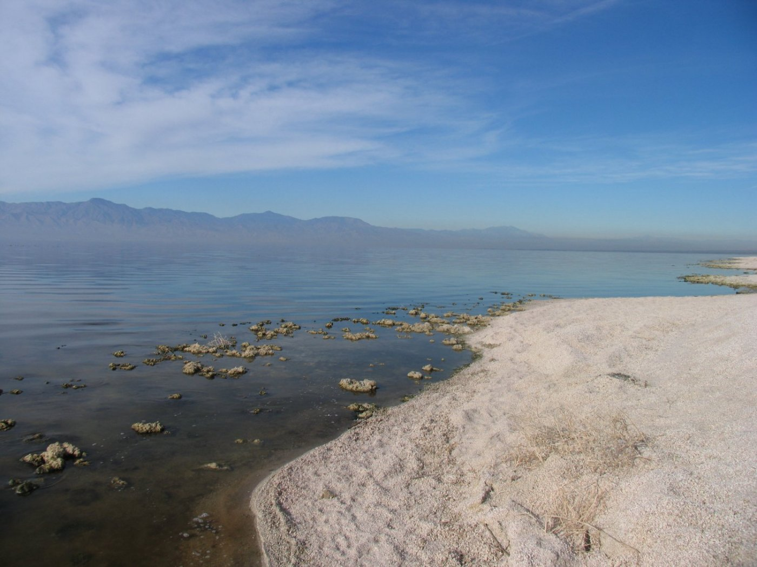
In 1900, a development company began constructing irrigation canals to divert water from the Colorado River into the Salton Sink.
The land became fertile, and crops were planted.
In 1905, heavy rainfall and snowmelt caused the river to swell and breach the dikes of the canals.
Two new rivers were carved out, causing the entire volume of the Colorado river to empty into the sink, creating the Salton Sea.

Slide 8
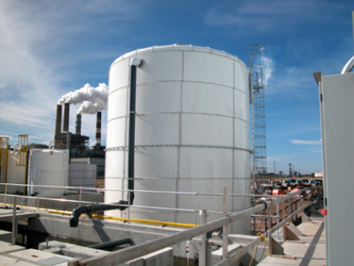
Water Purification
Countries without access to groundwater or surface water may resort to desalination, or the removal of salt from saltwater.
Desalinated water is much more expensive due to the high energy costs of operating the plants.
Tampa Bay desalination plant (power plant in background).

Slide 9
Drinking Water
Municipal tap water is regulated by the Environmental Protection Agency (EPA).
Standards are established within the Safe Drinking Water Act, passed in 1974.
Bottled water is regulated by the Food and Drug Administration (FDA), instead of the EPA.
Much less strict testing standards.
The FDA has set several different types or classifications of bottled water.

Slide 10
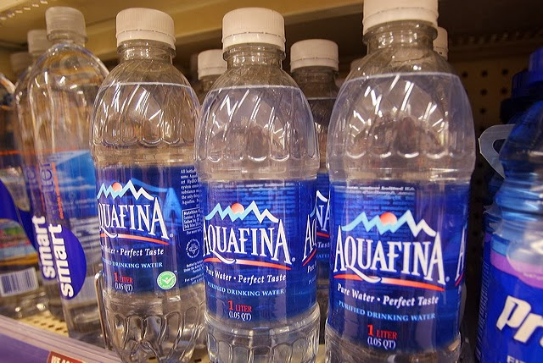
Artesian water – From a confined aquifer.
Fiji
Distilled – Water has been boiled and recollected. Contains no minerals.
Glaceau
Purified water – Water (probably tap) that has been filtered by deionization or reverse osmosis.
Aquafina, Dasani
Spring – From an underground formation that naturally flows to the surface.
Evian
Aquafina labels used to say “P.W.S.” instead of public water supply, giving the impression that it was spring water.

Slide 12
Domestic Water Conservation
Estimates suggest many societies could save as much as half of current domestic water usage without great sacrifice or serious change in lifestyle.
What are the biggest domestic uses of water?

Slide 13
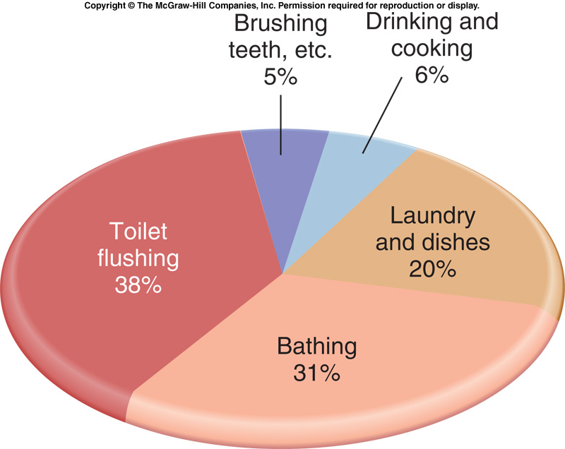

Slide 14
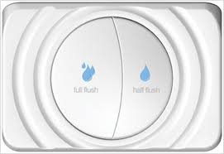
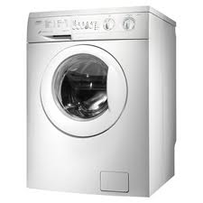
Water Conservation
Dual-flush toilet: Two buttons; half-flush for liquid waste, full-flush for solid.
High Efficiency washing machine: Half the water use of top-loaders.

Slide 15
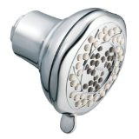
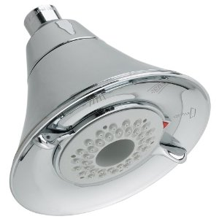
Water Conservation
Typical shower head: 2.5 gallons/minute.
Water-saver shower head: 1.5 gallons/minute.

Slide 16
Water Pollution
Water pollution is the addition of any substance that degrades, or lowers the quality of the water for living organisms.

Slide 17
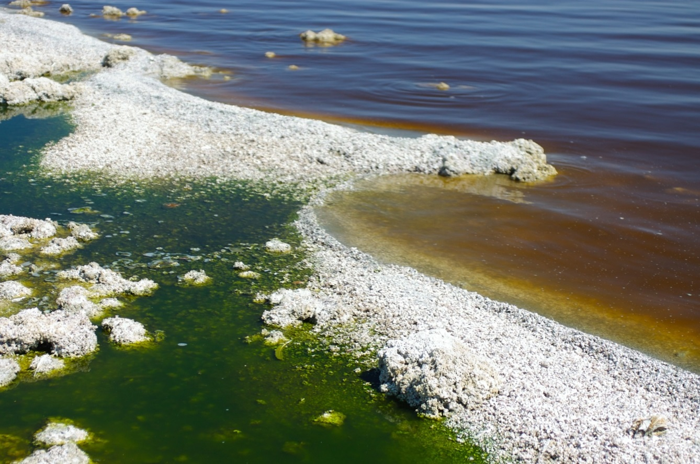
The Salton Sea has seen an large amount of nutrient pollution from excess fertilizer that has runoff from nearby farms.
Excess nutrient pollution causes eutrophication, or an overgrowth of algae.

Slide 18
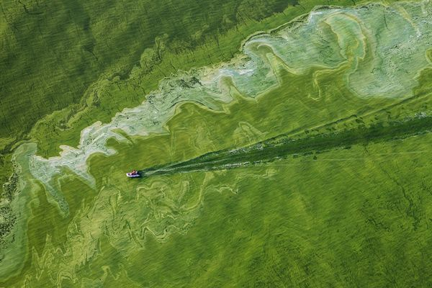
Algae blooms caused by eutrophication block sunlight from reaching underwater plants.
As the plants die, the dissolved oxygen (DO) levels of the water decline.
A decline in dissolved oxygen causes the suffocation of large organisms, like fish.
A boat moving through a 2011 algae bloom in Lake Erie. Photo by Peter Essick, National Geographic.

Slide 19
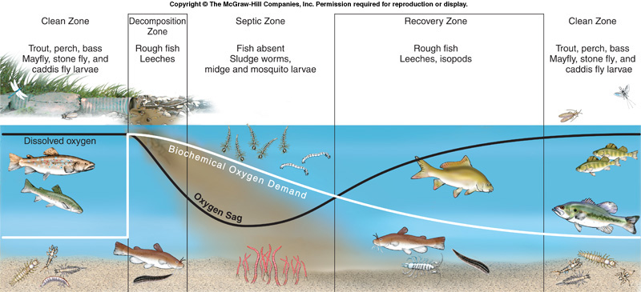
Dissolved oxygen levels can also plummet with the amount of oxygen consumed by bacterial decomposers in the water, called biological oxygen demand (BOD), suddenly increases.
This tends to happen from an influx of food such as raw sewage or dead algae.

Slide 20
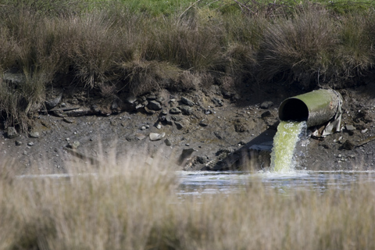
Types of Water Pollution
Fertilizer runoff is an example of nonpoint source pollution, because it does not come from a single discharge location.
Raw sewage discharged from a large pipe would be an example of point source pollution.
Discharge from the Arcata Wastewater Treatment Plant, California

Slide 21
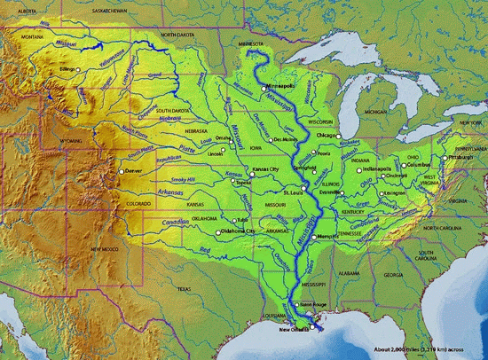
Nonpoint sources of pollution can enter a body of water from anywhere across its watershed – the area of land over which all rain and other water sources drain into it.
The Mississippi River watershed. Source: nature-education.org

Slide 22
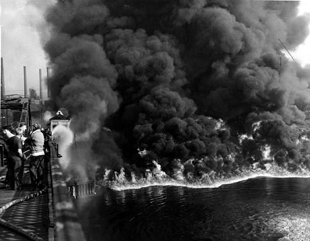
Clean Water Act
Beginning with the industrial revolution and continuing into the 1960s, water pollution was seen as a necessary consequence of growth and industry.
In 1969, the Cuyahoga River in Ohio caught fire, due to a buildup of oil on its surface.
Articles in Time Magazine and National Geographic spurred a movement that gave birth the first water pollution laws.
Cuyahoga River fire, 1952.

Slide 23
By 1972, about two-thirds of U.S. lakes, rivers, and coastal waters were unsafe for swimming and fishing.
The Clean Water Act, passed in 1977, is a law that set the allowable limits for various pollutants in surface waters.
Any point source may not discharge pollution into surface waters without a permit.
States are required to develop lists of impaired waters that are too polluted or degraded to meet water quality standards.

Slide 24
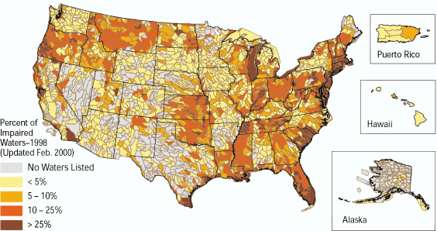
A large number of surface waters in the United States are still considered impaired.

Slide 25
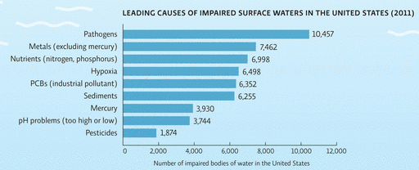
Leading causes of impaired waters include:
Pathogens; bacteria and parasites that cause disease.
Metals
Nutrient pollution from fertilizer runoff.
Oxygen-depleting pollution, such as raw sewage.
PCBs, synthetic chemicals found to be mutagenic and banned in 1979.
Sediment pollution from soil erosion.
Acid pollution, which lowers the pH of water.
Pesticide runoff.

Slide 26
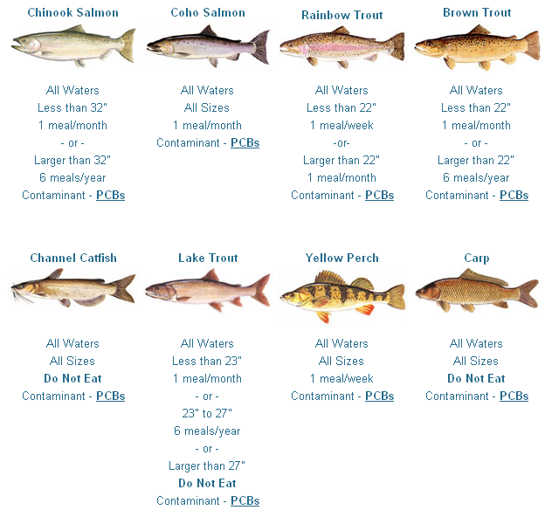
This guide to Lake Michigan fish shows the persistence of PCB pollution and its biomagnification in the food chain.

Slide 27
Ocean Pollution
The majority of pollution in the ocean falls into two categories:
Oil
Petroleum-based plastics

Slide 28
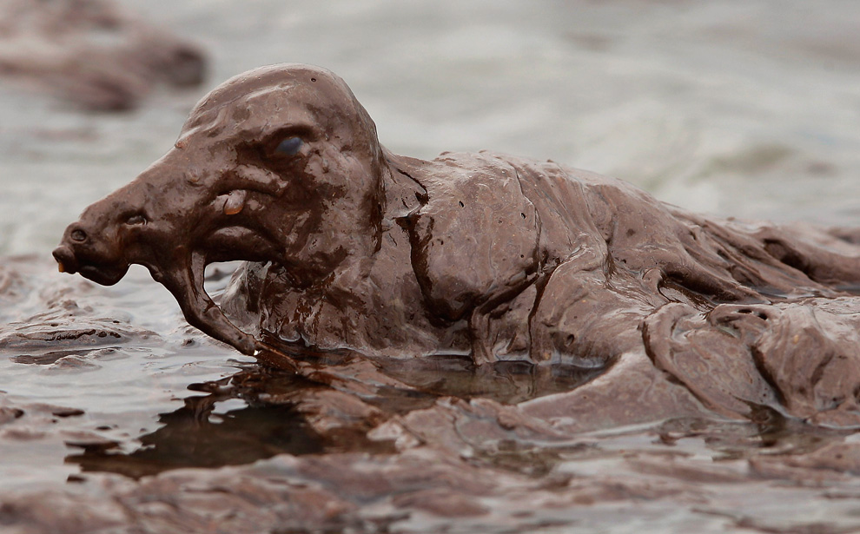
The biggest sources of oil in the ocean include:
Natural seeps from oil deposits at the ocean floor.
Runoff from land, including leaking cars and improper disposal of used motor oil.
This is the largest source.
Discharge from ships.
Spills from offshore drilling.
Spills from oil tanker accidents.
Oil penetrates the fur and feathers of animals, destroying the natural insulation.
Oil also directly damages the tissues of fish and other aquatic organisms.

Slide 29
Oil Spills
Although oil spills from rigs and tanker ships are not the biggest source of oil in the ocean, they have the most severe effects in the immediate area.
One of the worst spills to ever affect North America was the Exxon Valdez in 1989.

Slide 30
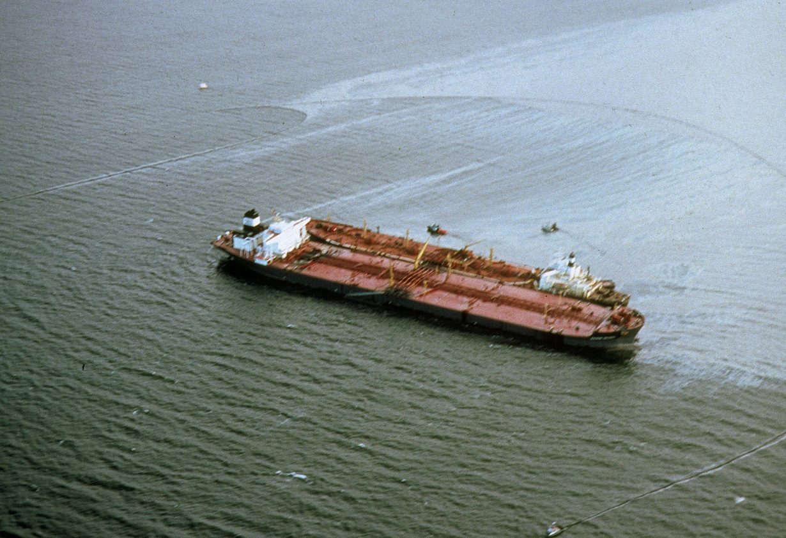
When the Exxon Valdez ran aground in Alaska, a high volume of oil was spilled.
The damage was worsened by a series of other factors:
The remoteness of the spill’s location.
A delayed cleanup response due to a lack of preparation by the oil companies.

Slide 31
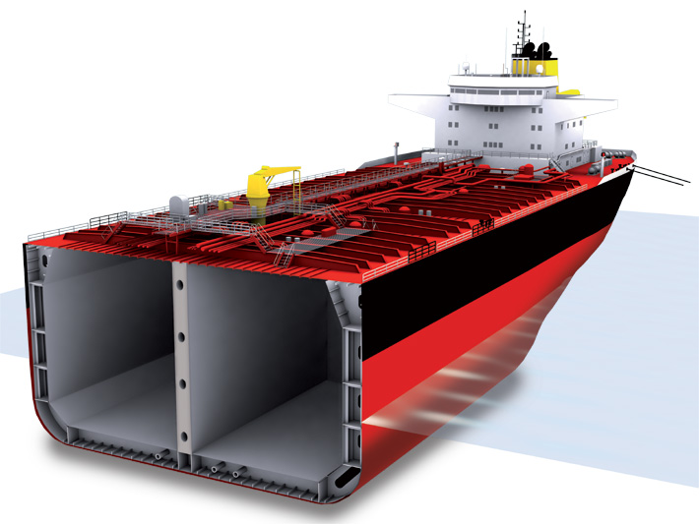
Following the Exxon Valdez spill, the Oil Pollution Act of 1990 made the following changes:
Operators of oil tankers are responsible for all cleanup costs.
Increased the maximum liability for losses by businesses and private individuals.
Phased out single-hulled tankers in favor of double-hulled tankers.
Reduces losses in an oil spill by 4-6 times.

Slide 32
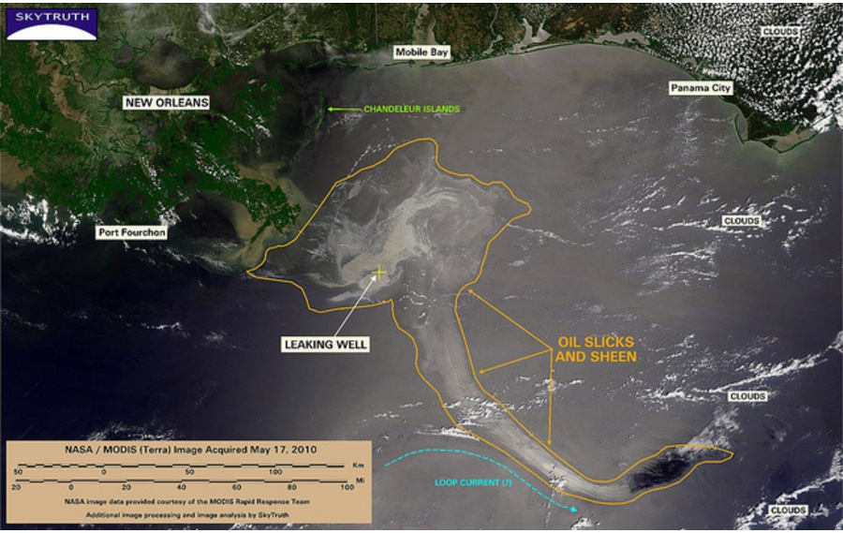
Deepwater Horizon
The worst oil spill by volume occurred in 2010 when an oil rig in the Gulf of Mexico experienced a blowout.
The drilled well at the bottom of the sea gushed nearly 5 million barrels of oil into the sea over a period of four months.

Slide 33
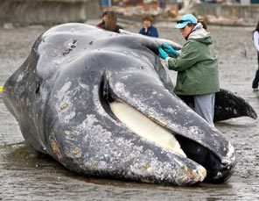
Plastic
A study by the Environmental Investigation Agency revealed that whales in the ocean were ingesting large amounts of plastic and fishing gear.
A gray whale stranded near Seattle was found to have the following in its stomach:
Sweatpants
Duct tape
Surgical gloves
Golf ball
More than 20 plastic bags

Slide 34
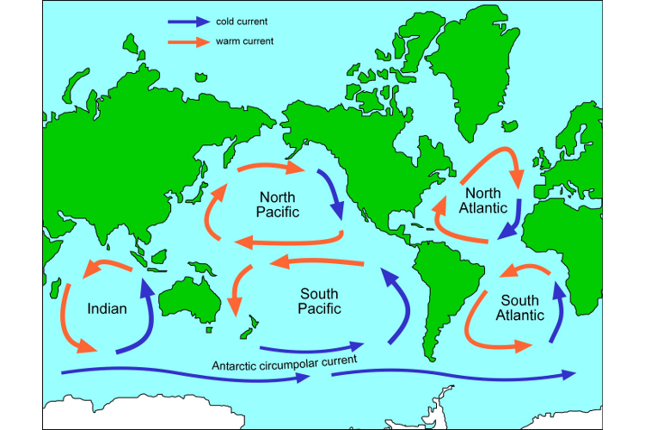
Plastic is non-degradable, meaning that it does not fully decompose in the environment.
Exposure to sunlight will cause it to break apart into smaller pieces, which accumulate in systems of rotating ocean currents called gyres.

Slide 35
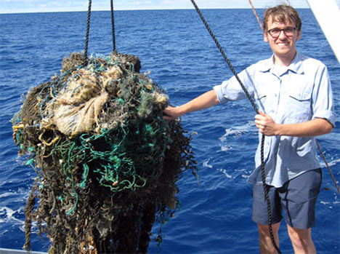
The largest collection of plastic pollution in the ocean is the Great Pacific Trash Vortex, located in the South Pacific gyre.
Most of the plastic is small and suspended below the surface.
The mass of plastic pieces sampled from this area is 6 times greater than the plankton biomass.
A sample of the plastic and fishing gear caught by filmmakers of the Garbage Island documentary.

Slide 36
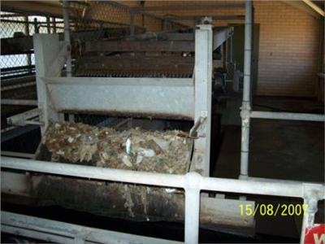
Wastewater Treatment
Human sewage is a waste product that is unavoidable, but it can be treated to minimize environmental impacts.
Screening removes any trash or large objects that may have entered the sewage stream.
Inlet Screen, Sewage Treatment Plant, Bateau Bay, Australia.

Slide 37
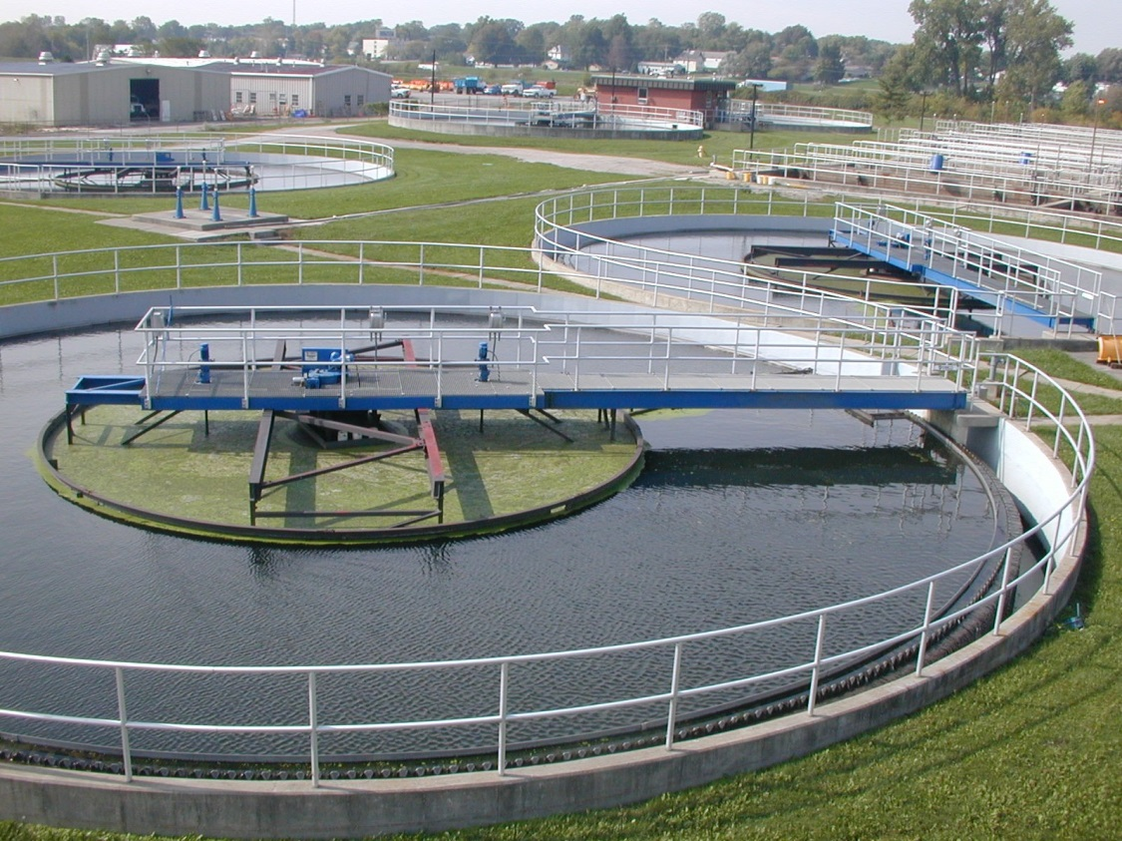
Wastewater Treatment
Primary treatment holds the sewage in a large containment vessel.
Heavy solids that sink to the bottom are removed as sludge.
May also be aerated to remove as much of the smell as possible.
The sludge that is leftover from these treatments is decomposed with bacteria or composted.

Slide 38
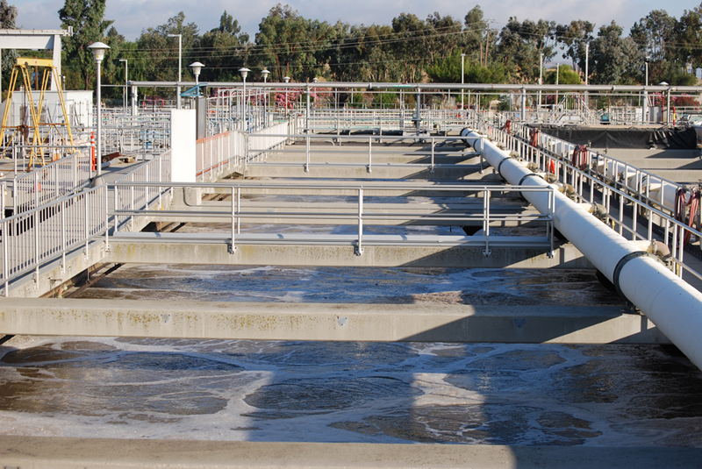
Secondary treatment adds bacteria to decompose the dissolved organic matter.
The bacteria must then be killed once the process is complete. This is usually done with chlorine.
Tertiary treatment is any additional treatment, such as the removal of nitrates and phosphates.

Slide 39
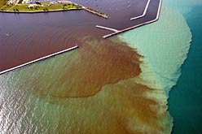
Sewer Overflow
Sewage treatment plants have a limited amount of water that can be processed at any given time.
If a flood, snow melt, or other excess water event occurs, raw sewage may be dumped directly into the nearby water body.
Sewage overflow plume in Milwaukee Harbor

